Slide 1
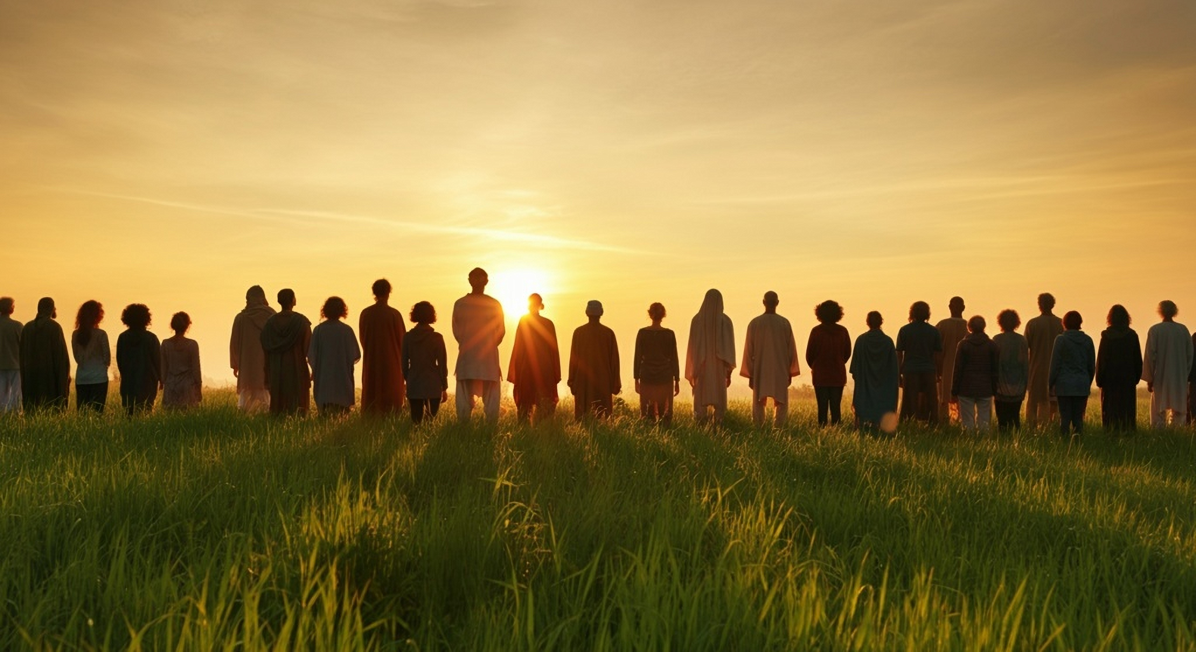


The Gift Too Wonderful for Words!
AFRI
Guyana Missions For Christ
Skip – A - Meal
North Haiti Mission
II Corinthians 9:1-15
Notes:
Stuart Fain ~ December 8, 2024 (AM)
Stuart Fain ~ October 18, 2025 (AM)

Slide 2
II Corinthians 9:1-15 (NLT)
¹ I really don't need to write to you about this ministry of giving for the believers in Jerusalem. ² For I know how eager you are to help, and I have been boasting to the churches in Macedonia that you in Greece were ready to send an offering a year ago.

Slide 3
II Corinthians 9:1-15 (NLT)
In fact, it was your enthusiasm that stirred up many of the Macedonian believers to begin giving. ³ But I am sending these brothers to be sure you really are ready, as I have been telling them, and that your money is all collected.

Slide 4
II Corinthians 9:1-15 (NLT)
I don't want to be wrong in my boasting about you.
⁴ We would be embarrassed—not to mention your own embarrassment—if some Macedonian believers came with me and found that you weren't ready after all I had told them!

Slide 5
II Corinthians 9:1-15 (NLT)
⁵ So I thought I should send these brothers ahead of me to make sure the gift you promised is ready. But I want it to be a willing gift, not one given grudgingly.

Slide 6
II Corinthians 9:1-15 (NLT)
⁶ Remember this—a farmer who plants only a few seeds will get a small crop. But the one who plants generously will get a generous crop. ⁷ You must each decide in your heart how much to give.

Slide 7
II Corinthians 9:1-15 (NLT)
And don't give reluctantly or in response to pressure. "For God loves a person who gives cheerfully."
⁸ And God will generously provide all you need. Then you will always have everything you need and plenty left over to share with others.

Slide 8
II Corinthians 9:1-15 (NLT)
⁹ As the Scriptures say, "They share freely and give generously to the poor. Their good deeds will be remembered forever."
¹⁰ For God is the one who provides seed for the farmer and then bread to eat.

Slide 9
II Corinthians 9:1-15 (NLT)
In the same way, he will provide and increase your resources and then produce a great harvest of generosity in you.

Slide 10
II Corinthians 9:1-15 (NLT)
¹¹ Yes, you will be enriched in every way so that you can always be generous.
And when we take your gifts to those who need them, they will thank God.
¹² So two good things will result from this ministry of giving —

Slide 11
II Corinthians 9:1-15 (NLT)
the needs of the believers in Jerusalem will be met, and they will joyfully express their thanks to God.

Slide 12
II Corinthians 9:1-15 (NLT)
¹³ As a result of your ministry, they will give glory to God. For your generosity to them and to all believers will prove that you are obedient to the Good News of Christ.

Slide 13
II Corinthians 9:1-15 (NLT)
¹⁴ And they will pray for you with deep affection because of the overflowing grace God has given to you.
¹⁵ Thank God for this gift too wonderful for words!

Slide 14
The gift
A.F.R.I (Akwa Ibom, Nigeria)
Guyana Missions (Guyana)
Skip-A-Meal (North Haiti)

Slide 15

African Family Resource International (A.F.R.I.)
Matthew 4:23-25 (NAS)

Slide 16
Matthew 4:23-25 (NAS)
²³ Jesus was going about in all of Galilee, teaching in their synagogues and proclaiming the gospel of the kingdom, and healing every disease and every sickness among the people.

Slide 17
Matthew 4:23-25 (NAS)
²⁴ And the news about Him spread throughout Syria; and they brought to Him all who were ill, those suffering with various diseases and severe pain, demon-possessed, people with epilepsy, and people who were paralyzed; and He healed them.

Slide 18
Matthew 4:23-25 (NAS)
²⁵ Large crowds followed Him from Galilee and the Decapolis, and Jerusalem, and Judea, and from beyond the Jordan.

Slide 19
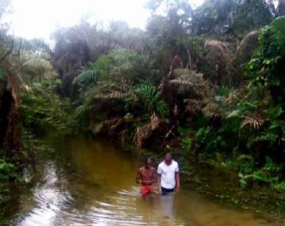

Evangelism:
Integrated into all Mission Aspects
Evangelist Student Home Visits
School Curriculum (Bible Knowledge)
Church Visitation by Students
Notes:
AI-generated content may be incorrect. --- Welcome to this executive board meeting focused on reviewing and highlighting our mission activities in Nigeria. We will cover our objectives, key achievements, challenges, and the future outlook for our operations in this vital African country. Image source: Microsoft 365 content library

Slide 20
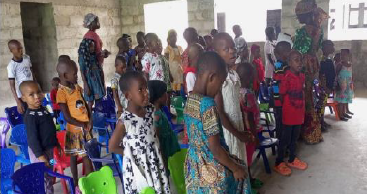
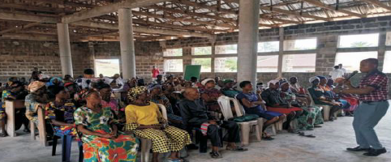
Construction:
Education Facility
Library
Solar Panels (new batteries)
Dormitory
Missions Skills & Technology Center
Notes:
AI-generated content may be incorrect. --- Welcome to this executive board meeting focused on reviewing and highlighting our mission activities in Nigeria. We will cover our objectives, key achievements, challenges, and the future outlook for our operations in this vital African country. Image source: Microsoft 365 content library

Slide 21
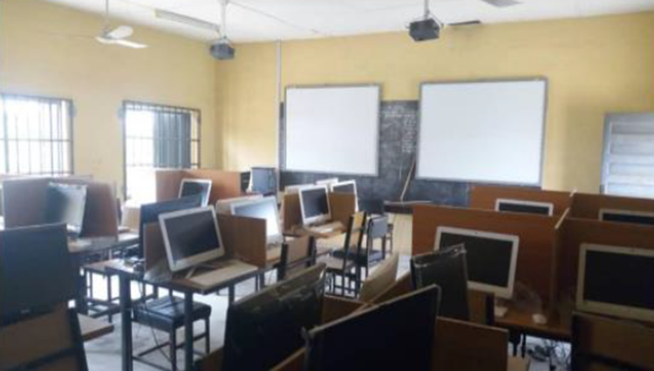
Transportation / IT:
Van Transportation Limited
StarLink Internet Service
Computers
Organization Staff Email Addresses
Notes:
AI-generated content may be incorrect. --- Welcome to this executive board meeting focused on reviewing and highlighting our mission activities in Nigeria. We will cover our objectives, key achievements, challenges, and the future outlook for our operations in this vital African country. Image source: Microsoft 365 content library

Slide 22

THE
CONDITIONS IN THE MISSION FIELD
SPIRITUAL NEEDS
PHYSICAL NEEDS
DAY TO DAY STRUGGLE TO SURVIVE AND AFFORD THE VERY BASICS NECESSITIES OF LIFE.
PURCHASING POWER VANISHED.
RURAL VILLAGES, THEY CAN’T EVEN FEED THEIR CHILDREN

Slide 23
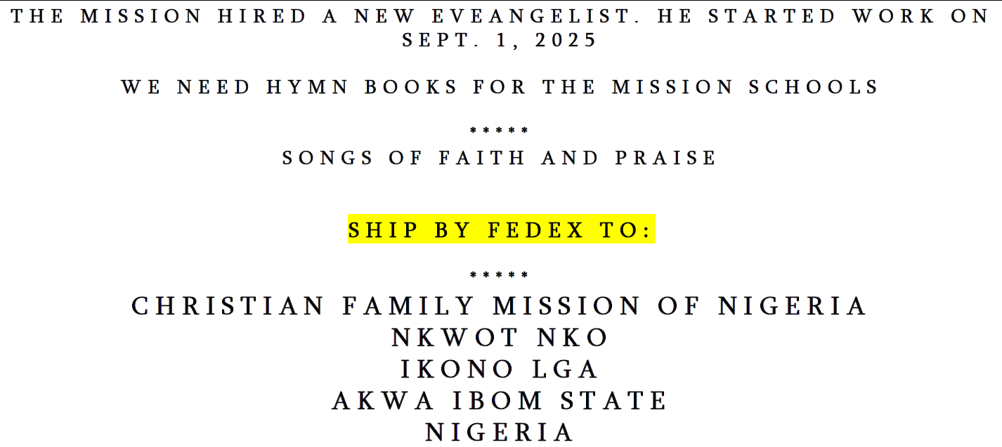

Slide 24

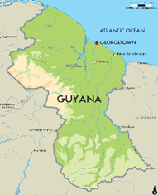
Guyana Missions For Christ
Georgetown School of Preaching
Building Worship Locations
Spreading the Gospel

Slide 25
Matthew 28:18-20 (KJV)
¹⁸ And Jesus came and spake unto them, saying, All power is given unto me in heaven and in earth.

Slide 26
Matthew 28:18-20 (KJV)
¹⁹ Go ye therefore, and teach all nations, baptizing them in the name of the Father, and of the Son, and of the Holy Ghost:

Slide 27
Matthew 28:18-20 (KJV)
²⁰ Teaching them to observe all things whatsoever I have commanded you: and, lo, I am with you always, even unto the end of the world. Amen.

Slide 28
Guyana Missions for Christ
Launch Laluni Building
Class of 2023-2025 Graduation Ceremony
New Blue Berry Hill Campus
Gospel Meetings & Daily Door Knocking
Notes:
AI-generated content may be incorrect. --- Welcome to this executive board meeting focused on reviewing and highlighting our mission activities in Nigeria. We will cover our objectives, key achievements, challenges, and the future outlook for our operations in this vital African country. Image source: Microsoft 365 content library

Slide 29
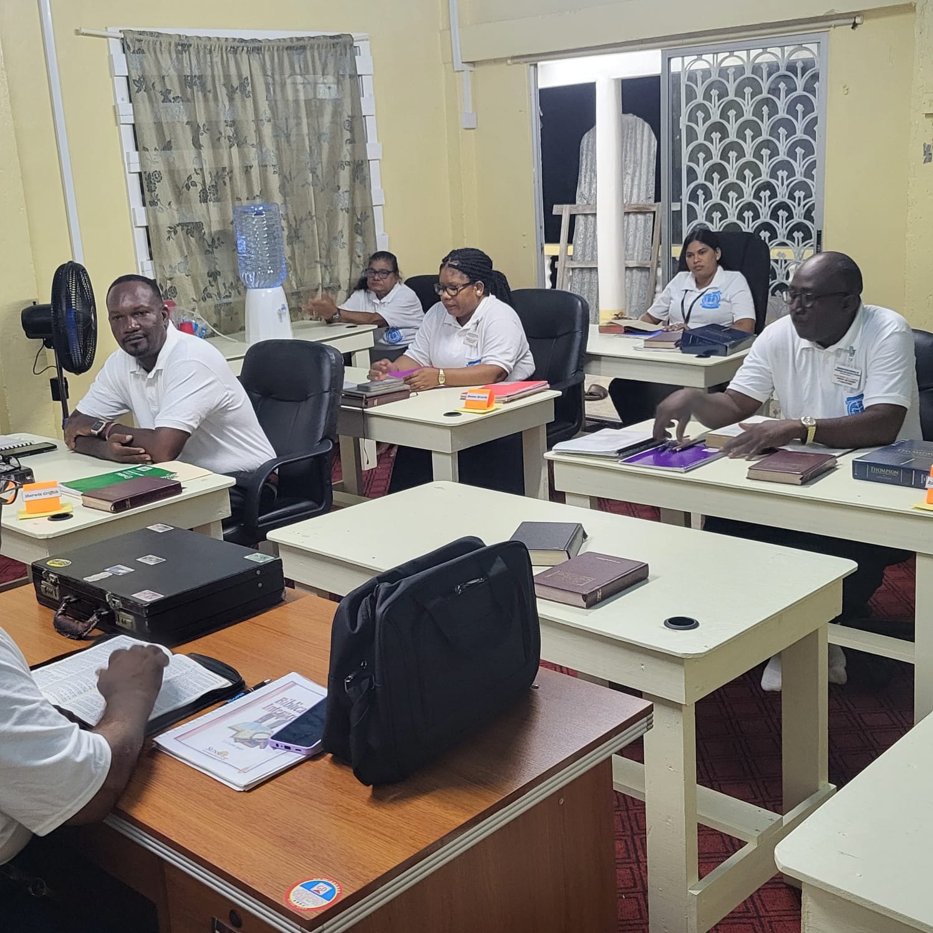
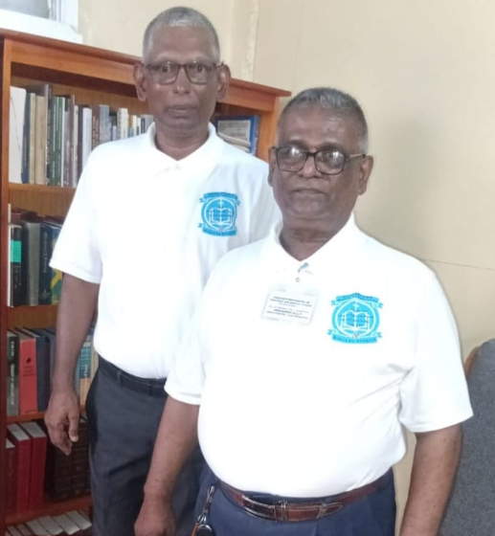
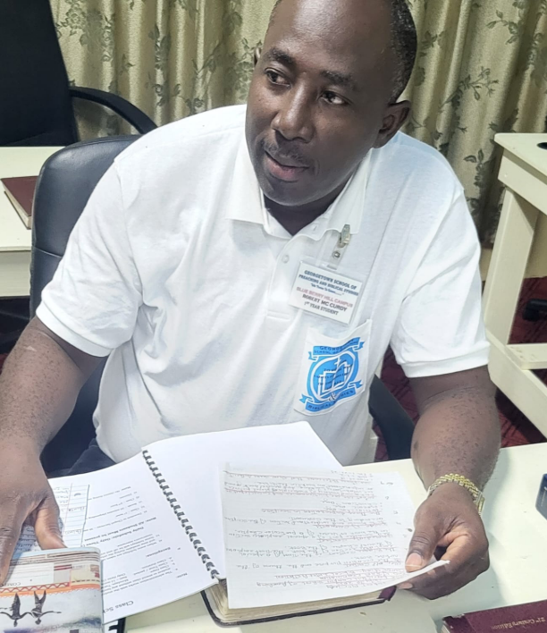
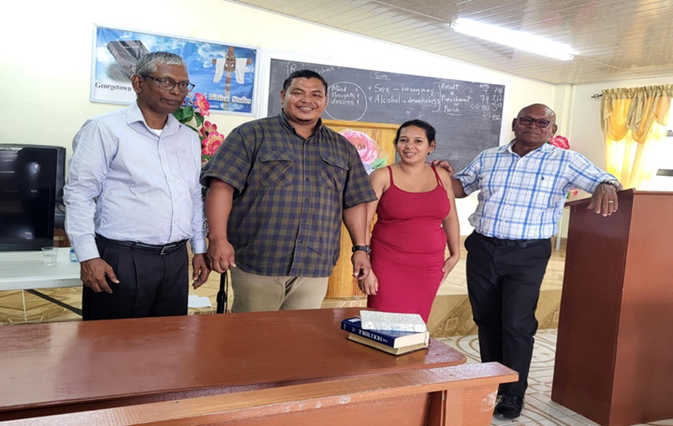
PREACHING & BIBLICAL STUDIES

Slide 30

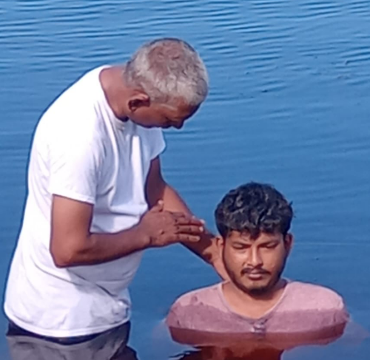
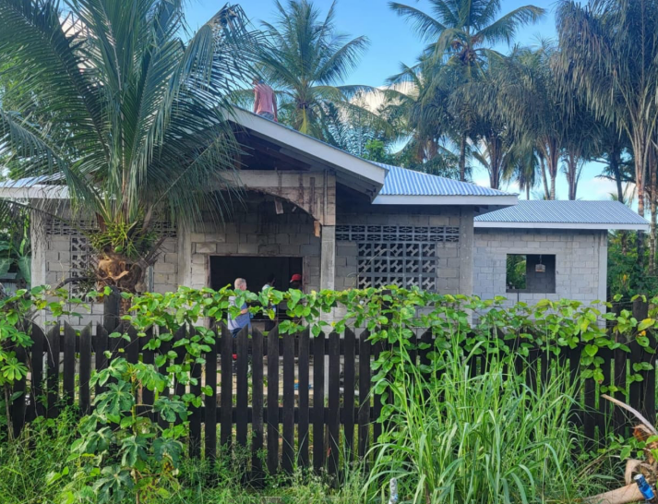

Expansions In Progress
Blue Berry Hill Campus
Laluni Building

Slide 31
Average Support
The current offering received at the sister congregations is minimal
Sophia Church offering is about $90 per week.
Kuru Kururu Church offerring is about $55 per week.

Slide 32


Skip–A–Meal
Acts 1:6-8 (NKJV)

Slide 33
Acts 1:6-8 (NKJV)
⁶ Therefore, when they had come together, they asked Him, saying, "Lord, will You at this time restore the kingdom to Israel?"

Slide 34
Acts 1:6-8 (NKJV)
⁷ And He said to them, "It is not for you to know times or seasons which the Father has put in His own authority.

Slide 35
Acts 1:6-8 (NKJV)
⁸ But you shall receive power when the Holy Spirit has come upon you; and you shall be witnesses to Me in Jerusalem, and in all Judea and Samaria, and to the end of the earth."

Slide 36
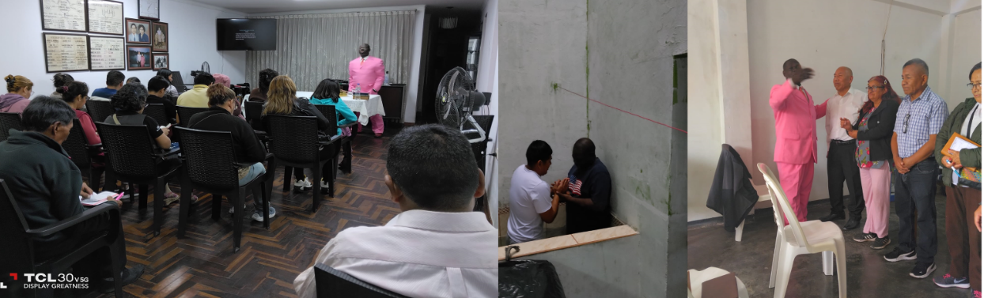
Preaching & Teaching Across 25 Countries

Slide 37
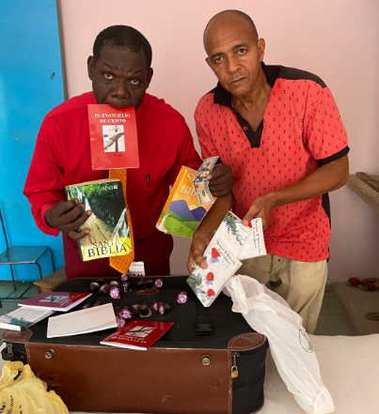
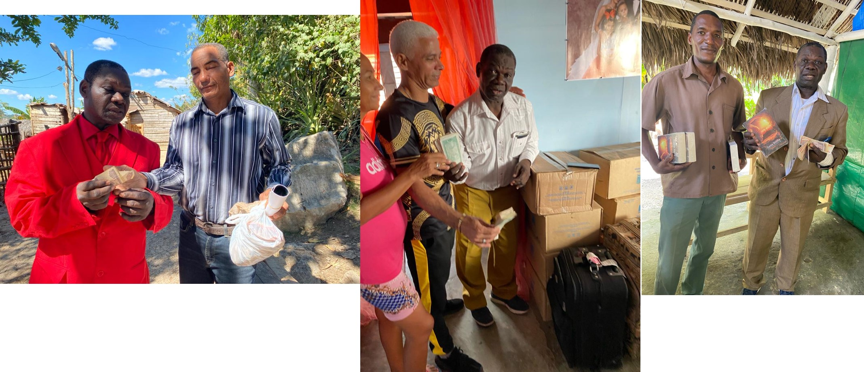
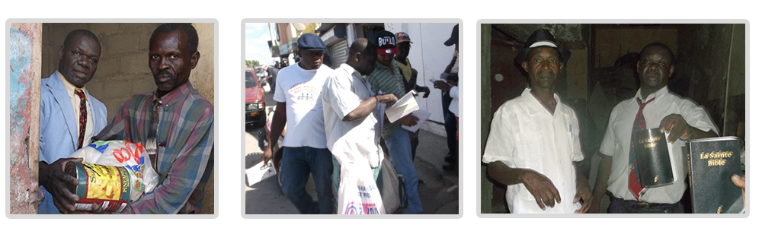
Providing Bibles, Song Books, Clothing & Food

Slide 38
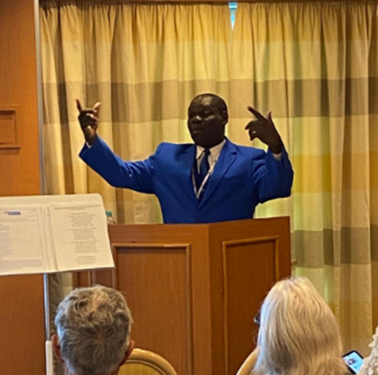
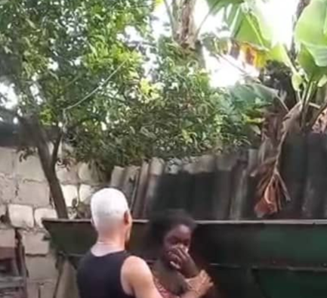
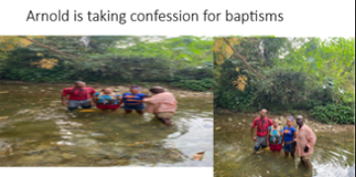
Baptisms & Restorations

Slide 39
2026 Contribution Forms are Available
African Family Resource International
Guyana Missions for Christ
Skip-A-Meal will continue a Love Offering collection every 3rd Sunday

Slide 40

…that Christ died for our sins according to the scriptures; And that he was buried, and that he rose again the third day according to the scriptures:

Slide 41

Hear: Romans 10:17
So then faith cometh by hearing, and hearing by the word of God.

Slide 42
Believe: Hebrews 11:6
But without faith it is impossible to please him: for he that cometh to God must believe that he is, and that he is a rewarder of them that diligently seek him.

Slide 43
Repent: Luke 13:3
I tell you, Nay: but, except ye repent, ye shall all likewise perish.

Slide 44
Confess: Matthew 10:32-33
32 Whosoever therefore shall confess me before men, him will I confess also before my Father which is in heaven.
33 But whosoever shall deny me before men, him will I also deny before my Father which is in heaven.

Slide 45
Baptize: Acts 22:16
And now why tarriest thou? arise, and be baptized, and wash away thy sins, calling on the name of the Lord.

